Slide 1






nexBit
Explore and manage Bitcoin securely on the Internet Computer
Explore Now
01
Notes:
Welcome to nexBit, a 100% decentralized platform to securely explore and manage Bitcoin. Built on the Internet Computer, nexBit combines wallet functionality and blockchain exploration into one seamless experience. With no reliance on centralized systems, it ensures privacy, security, and scalability. Lets ‘Explore Now’ to get started!

Slide 2

Centralized Risks
Poor User Experience
Problem
Lack of Integration
Limited Blockchain Insights
02
Notes:
Bitcoin wallets and explorers are often centralized, which makes them prone to data breaches and puts users at risk of third-party control. On top of this, existing blockchain tools provide a poor user experience, forcing users to juggle multiple platforms for wallet and explorer functionalities. Most platforms fail to integrate secure wallets and reliable explorers, leaving users without a unified solution. Lastly, users struggle to access real-time blockchain insights like fee trends, UTXOs, and balances in an intuitive and user-friendly way.

Slide 3
Solution
Unified Platform
Advanced Insights
User-Centric Design
Secure Transactions
100% Decentralized
Scalable Architecture
03
Notes:
nexBit offers a unified platform that seamlessly combines wallet and explorer functionalities, all 100% decentralized, with the frontend, backend, and authentication hosted on-chain. Its user-centric design ensures simplicity for everyone. On the explorer side, it provides advanced insights into real-time blockchain data like balances, UTXOs, and fees. Users can perform secure transactions powered by Internet Identity, and the platform's scalable architecture ensures it’s built for future growth.

Slide 4





Explorer
Search Bitcoin addresses for balances and transaction details.
Analyze UTXOs and view real-time fee percentiles.
Explore recent blocks and network statistics with rich visualizations.
Key Features
100% Decentalised Architecture
Wallet
Backend: Hosted on the Internet Computer for reliability and security.
Frontend: Fully deployed on-chain to ensure scalability and availability.
Authentication: Internet Identity for seamless, password-free login.
Send and receive Bitcoin securely with real-time confirmations.
Generate addresses for payments or storage.
View balance and transaction history in a user-friendly interface.
04
Notes:
nexBit offers a robust feature set for Bitcoin users. The Explorer allows users to search addresses, view balances, analyze UTXOs, and track fee percentiles with rich visualizations. The Wallet enables secure Bitcoin transactions, real-time balance updates, and address generation for storage or payments. All of this is built on a 100% decentralized architecture, with the backend, frontend, and authentication hosted entirely on the Internet Computer, ensuring reliability, scalability, and a seamless, password-free user experience.

Slide 5
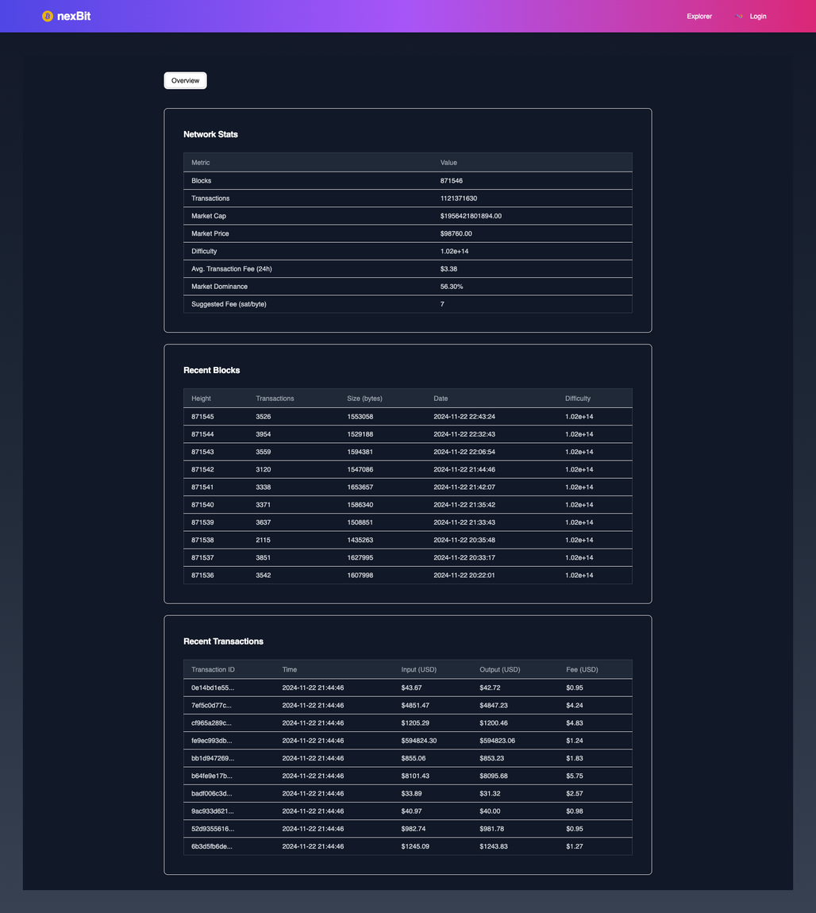
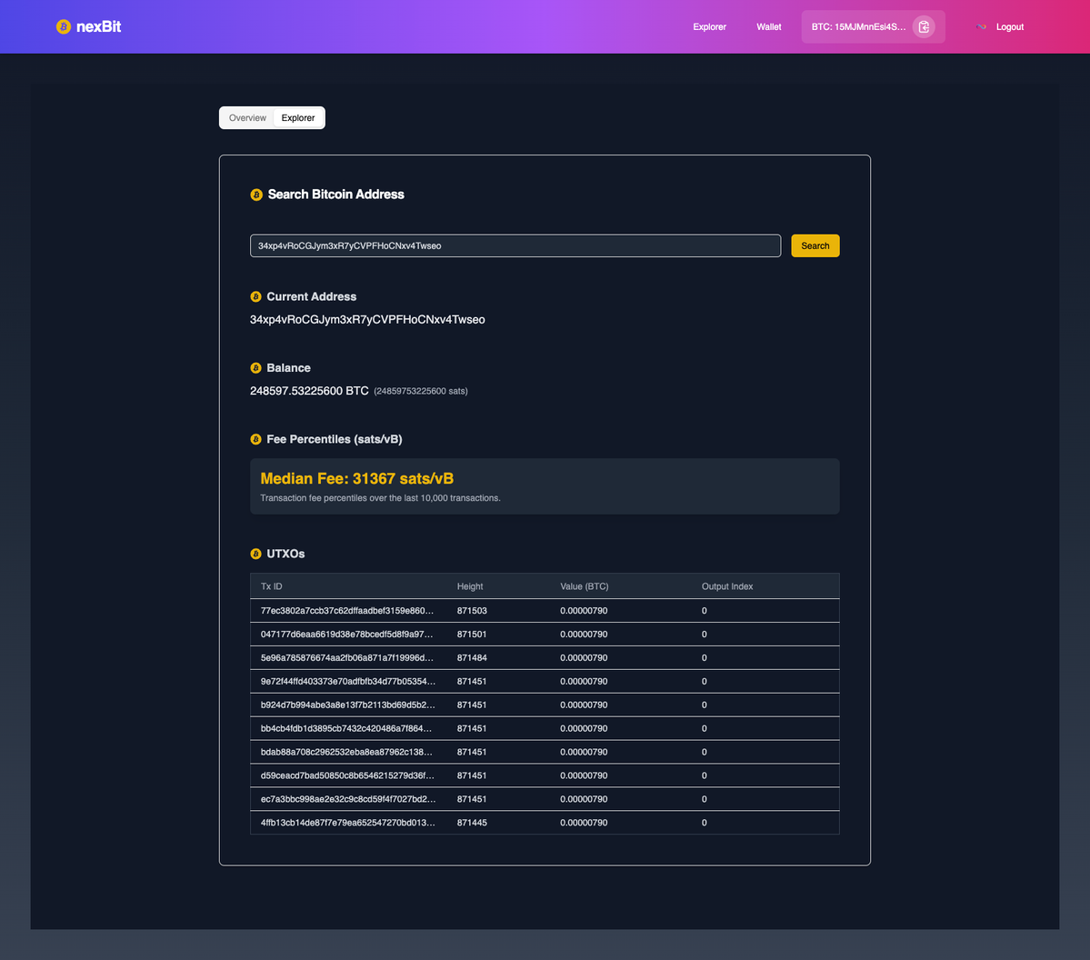
Bitcoin Stats
Explorer
05
Notes:
Let’s take a quick look at the nexBit demo, starting with the explorer and Bitcoin stats.
On the left, you’ll see detailed network stats, including market cap, transaction fees, and recent block data. This gives users a real-time snapshot of the Bitcoin network.
On the right, the explorer allows users to search Bitcoin addresses, analyze real-time fee percentiles, and track UTXOs. It provides complete transparency and control over Bitcoin transactions, making it a powerful tool for both beginners and advanced users.”

Slide 6
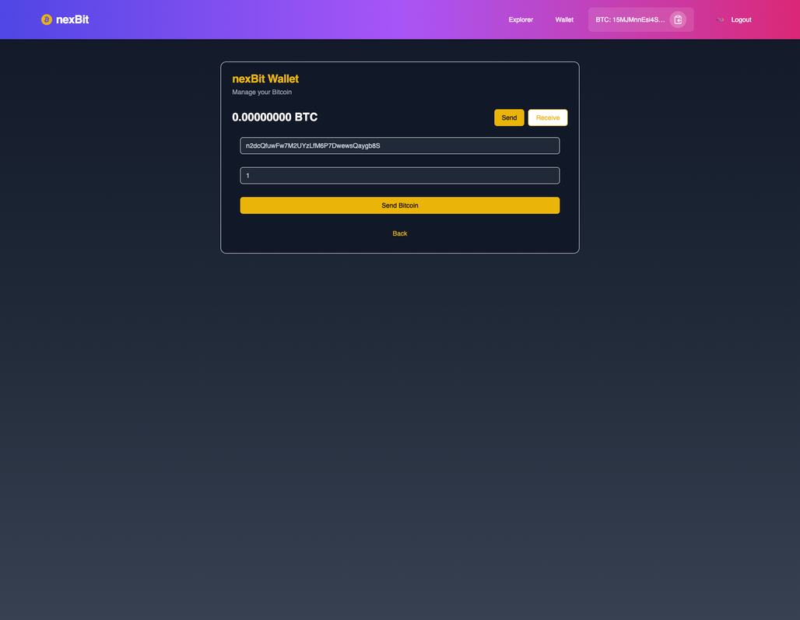
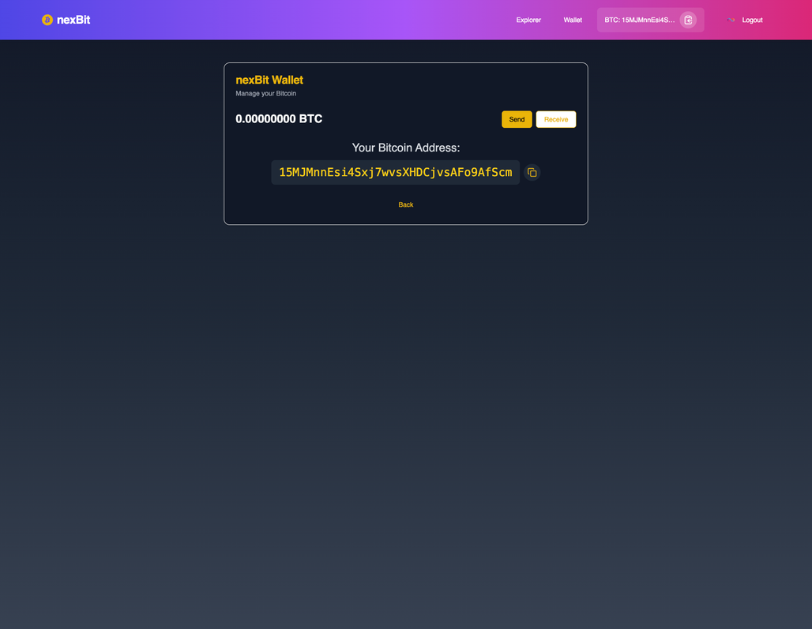
Wallet
Send
Receive
06
Notes:
Now, let’s look at the wallet functionality, designed to be intuitive and secure.
On the left, the Send feature allows users to send Bitcoin to any address with real-time confirmations, ensuring secure transactions.
On the right, the Receive feature generates a unique Bitcoin address for receiving payments safely and effortlessly. This simple interface bridges the gap between usability and advanced blockchain functionality.

Slide 7

React, Tailwind & Shadcn UI
Technology Stack
Rust Backend
Internet Identity Authentication
07
Notes:
The frontend is built with React, Tailwind CSS, and ShadCN for a responsive and modern UI. The backend uses Rust for high performance and integrates Bitcoin APIs on the Internet Computer. Authentication is handled through Internet Identity, ensuring secure, decentralized, and password-free access.

Slide 8
Progress & Roadmap
Advanced Analytics Dashboard
Fully Functional Platform
User-Centric Design
Chain Key Token Integration
Real-Time Blockchain Data
Ethereum Wallet Support
08
Notes:
nexBit is a fully functional platform offering a user-centric design and real-time blockchain data. Moving forward, we’ll enhance our analytics dashboard for deeper blockchain insights, integrate Chain Key Tokens to enable seamless cross-chain transactions, and add Ethereum wallet support to manage ETH and ERC-20 tokens, making nexBit a multi-chain solution.

Slide 9

Thank
You
Explore nexBit with our Live Demo
Noah Sheldon
09
Notes:
Thank you for your time and attention! I invite you to explore nexBit further through our Live Demo. If you’d like to collaborate or have any questions, feel free to reach out. Together, let’s redefine Bitcoin management with a secure, decentralized, and user-centric platform.

